Slide 1
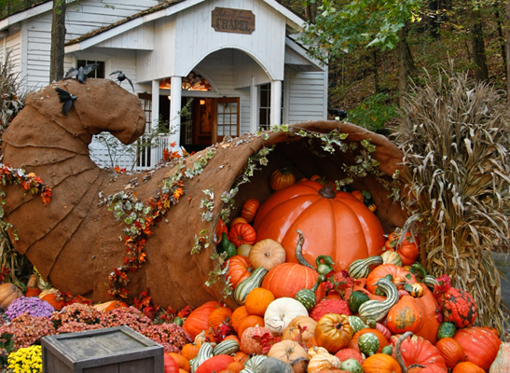
Thanksgiving in America

Slide 2
394 years ago the Pilgrims sailed to America

Slide 3
They were in search of a new life

Slide 4
They wanted the freedom to worship God freely

Slide 5
September 1620

Slide 6
The Pilgrims Sailed to America

Slide 7
The Mayflower

Slide 8
A Difficult Journey

Slide 9
The Pilgrims Landed in America November 11, 1620

Slide 10
The First Winter in America

Slide 11
Pilgrims and Native Americans

Slide 12
Pilgrims in America

Slide 13
First Thanksgiving

Slide 14
Three-day Celebration

Slide 15
The Menu

Slide 16
Turkey

Slide 17
Deer

Slide 18
Cod

Slide 19
Lobster

Slide 20
Clams and Mussels

Slide 21
The Harvest

Slide 22
Corn

Slide 23
Walnuts

Slide 24
Chestnuts

Slide 25
Raspberries

Slide 26
Strawberries

Slide 27
Today in America

Slide 28
Parades

Slide 29
American Football

Slide 30
The First Thanksgiving

Slide 31
Abraham Lincoln’s Thanksgiving Day Proclamation of 1863

Slide 32
“…announced in the Holy Scriptures and proven by all history, that those nations are blessed whose God is the Lord… But we have forgotten God. We have forgotten the gracious hand, which preserved us in peace and multiplied and enriched and strengthened us, and we have vainly imagined, by the deceitfulness of our hearts, that all these blessings were produced by some superior wisdom and virtue of our own… It has seemed to me fit and proper that God should be solemnly, reverently and gratefully acknowledged, as with one heart and one voice, by the whole American people…”

